Slide 1



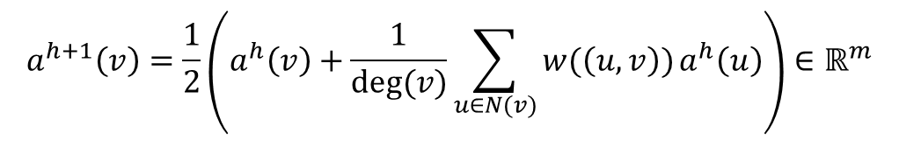


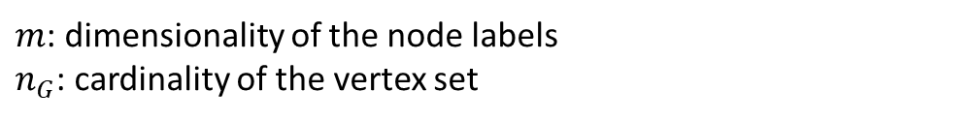

$m$: dimensionality of the node labels
$n_{G}$: cardinality of the vertex set
$$N^{h}(v)=\left\{l^{h}\left(u_{0}\right), …,l^{h}\left(u_{\deg\left(v\right)−1}\right)\right\}$$
$N(v)$ neighbourhood of $v$
$$l^{h+1}\left(v\right)=hash(l^{h}\left(v\right), N^{h}(v))∈ℝ^{m}$$
$$a^{h+1}\left(v\right)=\frac{1}{2}\left(a^{h}\left(v\right)+\frac{1}{deg⁡(v)}\sum_{u∈N(v)}{w(\left(u,v\right))}a^{h}\left(u\right)\right)∈ℝ^{m}$$
$$x^{h}\left(v_{i}\right)=l^{h}\left(v_{i}\right)$$
$$x^{h}\left(v_{i}\right)=a^{h}\left(v_{i}\right)$$
$$X_{G}^{h}={\left[x^{h}\left(v_{1}\right),…,x^{h}(v_{n_{G}})\right]}^{T}∈ℝ^{n_{G}×m}$$
$f^{H}:G⟶\left(X_{G}^{0}, …{,X}_{G}^{H}\right)∈ℝ^{n_{G}×m(H+1)}$ (concatenation)

Slide 7



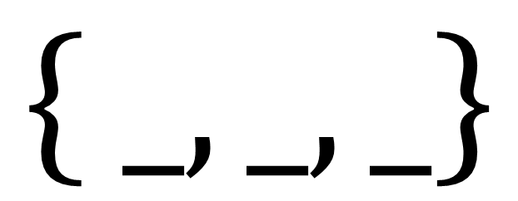
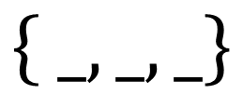
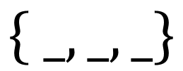



$$\left\{ _, _,_\right\}$$
$$\left\{ _, _,_\right\}$$
$$=$$
$$≠$$
$$≠$$
$$\left\{ _, _,_\right\}$$
$$1$$
$$2$$
$$⟹d_{Ham}=2$$

Slide 8
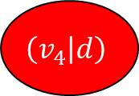
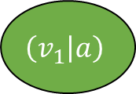
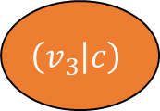
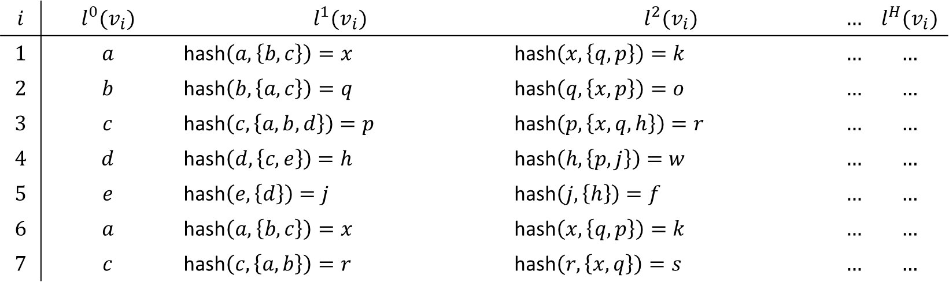
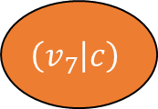
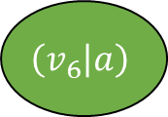
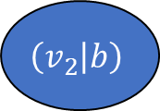
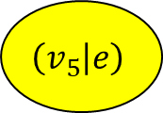
$$\left(v_{1} | a\right)$$
$$\left(v_{2} | b\right)$$
$$\left(v_{6} | a\right)$$
$$\left(v_{3} | c\right)$$
$$\left(v_{7} | c\right)$$
$$\left(v_{4} | d\right)$$
$$\left(v_{5} | e\right)$$
$$i$$ | $$l^{0}(v_{i})$$ | $$l^{1}(v_{i})$$ | $$l^{2}(v_{i})$$ | $$…$$ | $$l^{H}(v_{i})$$
$$1$$ | $$a$$ | hash$\left(a,\left\{b, c\right\}\right)=x$ | hash$\left(x,\left\{q, p\right\}\right)=k$ | $$…$$ | $$…$$
$$2$$ | $$b$$ | hash$\left(b,\left\{a, c\right\}\right)=q$ | hash$\left(q,\left\{x, p\right\}\right)=o$ | $$…$$ | $$…$$
$$3$$ | $$c$$ | hash$\left(c,\left\{a, b,d\right\}\right)=p$ | hash$\left(p,\left\{x,q,h\right\}\right)=r$ | $$…$$ | $$…$$
$$4$$ | $$d$$ | hash$\left(d,\left\{c, e\right\}\right)=h$ | hash$\left(h,\left\{p,j\right\}\right)=w$ | $$…$$ | $$…$$
$$5$$ | $$e$$ | hash$\left(e,\left\{d\right\}\right)=j$ | hash$\left(j,\left\{h\right\}\right)=f$ | $$…$$ | $$…$$
$$6$$ | $$a$$ | hash$\left(a,\left\{b, c\right\}\right)=x$ | hash$\left(x,\left\{q,p\right\}\right)=k$ | $$…$$ | $$…$$
$$7$$ | $$c$$ | hash$\left(c,\left\{a, b\right\}\right)=r$ | hash$\left(r,\left\{x,q\right\}\right)=s$ | $$…$$ | $$…$$

Slide 9
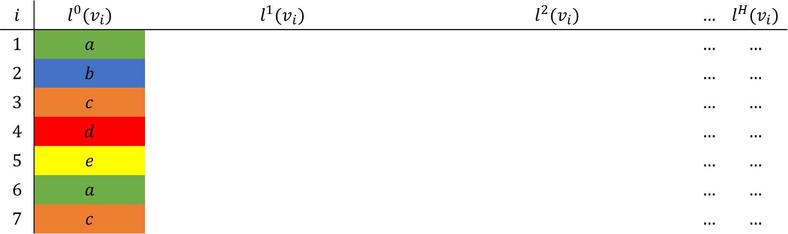
$$\left(v_{1} | a\right)$$
$$\left(v_{2} | b\right)$$
$$\left(v_{6} | a\right)$$
$$\left(v_{3} | c\right)$$
$$\left(v_{7} | c\right)$$
$$\left(v_{4} | d\right)$$
$$\left(v_{5} | e\right)$$
$$i$$ | $$l^{0}(v_{i})$$ | $$l^{1}(v_{i})$$ | $$l^{2}(v_{i})$$ | $$…$$ | $$l^{H}(v_{i})$$
$$1$$ | $$a$$ |  |  | $$…$$ | $$…$$
$$2$$ | $$b$$ |  |  | $$…$$ | $$…$$
$$3$$ | $$c$$ |  |  | $$…$$ | $$…$$
$$4$$ | $$d$$ |  |  | $$…$$ | $$…$$
$$5$$ | $$e$$ |  |  | $$…$$ | $$…$$
$$6$$ | $$a$$ |  |  | $$…$$ | $$…$$
$$7$$ | $$c$$ |  |  | $$…$$ | $$…$$

Slide 10
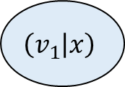
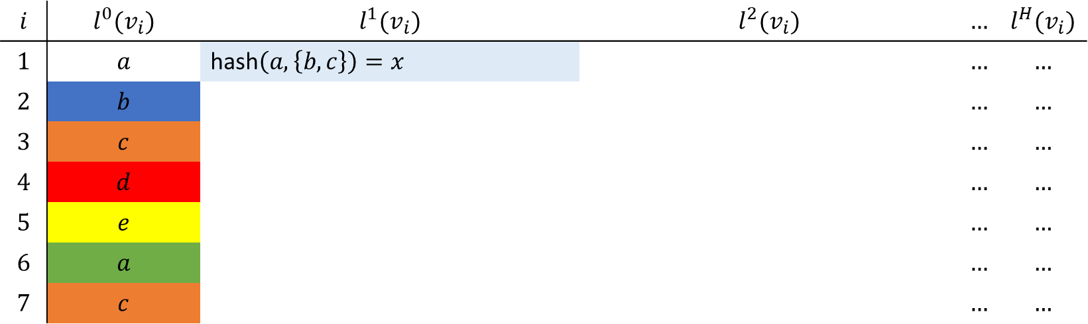
$$\left(v_{1} | x\right)$$
$$\left(v_{2} | b\right)$$
$$\left(v_{6} | a\right)$$
$$\left(v_{3} | c\right)$$
$$\left(v_{7} | c\right)$$
$$\left(v_{4} | d\right)$$
$$\left(v_{5} | e\right)$$
$$i$$ | $$l^{0}(v_{i})$$ | $$l^{1}(v_{i})$$ | $$l^{2}(v_{i})$$ | $$…$$ | $$l^{H}(v_{i})$$
$$1$$ | $$a$$ | hash$\left(a,\left\{b, c\right\}\right)=x$ |  | $$…$$ | $$…$$
$$2$$ | $$b$$ |  |  | $$…$$ | $$…$$
$$3$$ | $$c$$ |  |  | $$…$$ | $$…$$
$$4$$ | $$d$$ |  |  | $$…$$ | $$…$$
$$5$$ | $$e$$ |  |  | $$…$$ | $$…$$
$$6$$ | $$a$$ |  |  | $$…$$ | $$…$$
$$7$$ | $$c$$ |  |  | $$…$$ | $$…$$

Slide 11
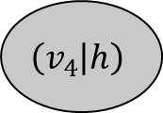
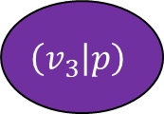
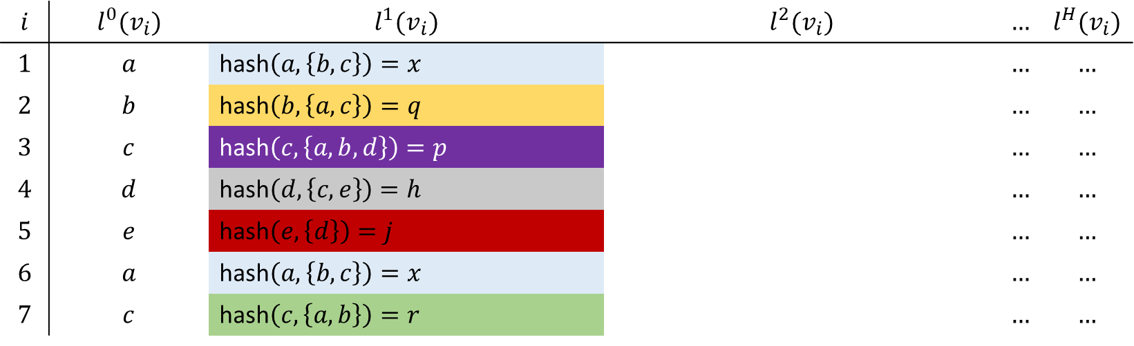
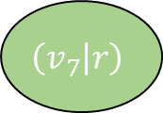
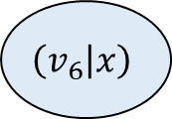
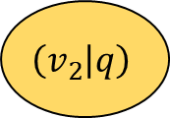
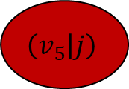
$$\left(v_{1} | x\right)$$
$$\left(v_{2} | q\right)$$
$$\left(v_{6} | x\right)$$
$$\left(v_{3} | p\right)$$
$$\left(v_{7} | r\right)$$
$$\left(v_{4} | h\right)$$
$$\left(v_{5} | j\right)$$
$$i$$ | $$l^{0}(v_{i})$$ | $$l^{1}(v_{i})$$ | $$l^{2}(v_{i})$$ | $$…$$ | $$l^{H}(v_{i})$$
$$1$$ | $$a$$ | hash$\left(a,\left\{b, c\right\}\right)=x$ |  | $$…$$ | $$…$$
$$2$$ | $$b$$ | hash$\left(b,\left\{a, c\right\}\right)=q$ |  | $$…$$ | $$…$$
$$3$$ | $$c$$ | hash$\left(c,\left\{a, b,d\right\}\right)=p$ |  | $$…$$ | $$…$$
$$4$$ | $$d$$ | hash$\left(d,\left\{c, e\right\}\right)=h$ |  | $$…$$ | $$…$$
$$5$$ | $$e$$ | hash$\left(e,\left\{d\right\}\right)=j$ |  | $$…$$ | $$…$$
$$6$$ | $$a$$ | hash$\left(a,\left\{b, c\right\}\right)=x$ |  | $$…$$ | $$…$$
$$7$$ | $$c$$ | hash$\left(c,\left\{a, b\right\}\right)=r$ |  | $$…$$ | $$…$$
Note that N(v) is a set – not a multi set!! Example for v_3

Slide 12


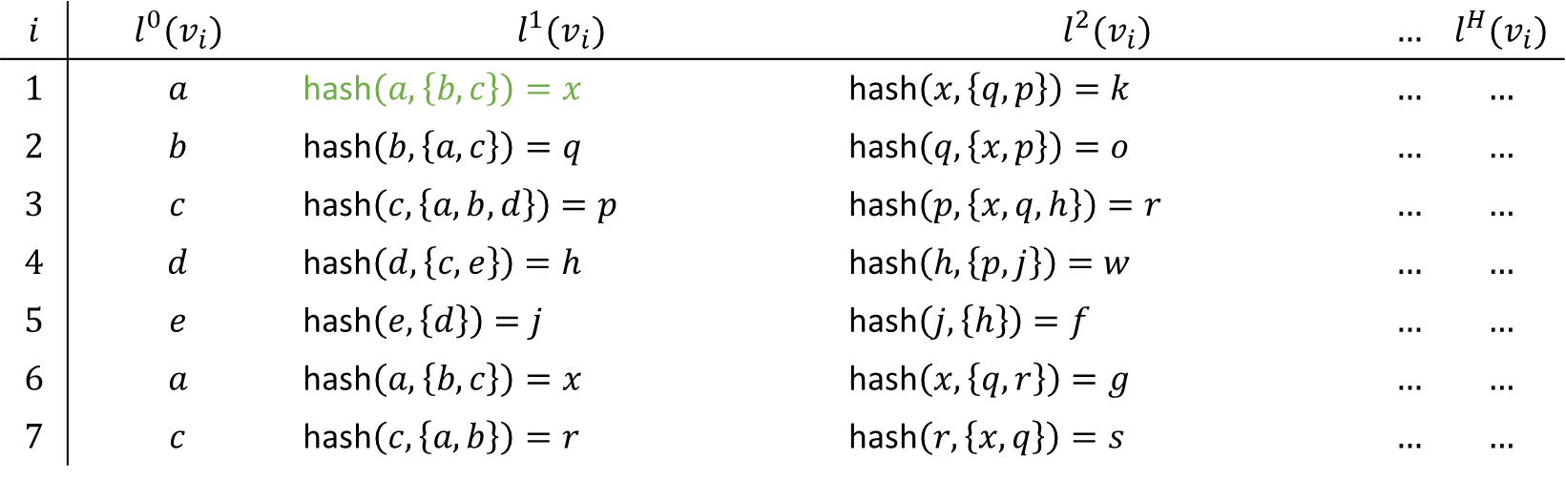





$$\left(v_{1} | x\right)$$
$$\left(v_{2} | q\right)$$
$$\left(v_{6} | x\right)$$
$$a$$
$$b$$
$$a$$
$$\left(v_{3} | p\right)$$
$$\left(v_{7} | r\right)$$
$$c$$
$$c$$
$$d$$
$$e$$
$$\left(v_{4} | h\right)$$
$$\left(v_{5} | j\right)$$
$$i$$ | $$l^{0}(v_{i})$$ | $$l^{1}(v_{i})$$ | $$l^{2}(v_{i})$$ | $$…$$ | $$l^{H}(v_{i})$$
$$1$$ | $$a$$ | hash$\left(a,\left\{b, c\right\}\right)=x$ | hash$\left(x,\left\{q, p\right\}\right)=k$ | $$…$$ | $$…$$
$$2$$ | $$b$$ | hash$\left(b,\left\{a, c\right\}\right)=q$ | hash$\left(q,\left\{x, p\right\}\right)=o$ | $$…$$ | $$…$$
$$3$$ | $$c$$ | hash$\left(c,\left\{a, b,d\right\}\right)=p$ | hash$\left(p,\left\{x,q,h\right\}\right)=r$ | $$…$$ | $$…$$
$$4$$ | $$d$$ | hash$\left(d,\left\{c, e\right\}\right)=h$ | hash$\left(h,\left\{p,j\right\}\right)=w$ | $$…$$ | $$…$$
$$5$$ | $$e$$ | hash$\left(e,\left\{d\right\}\right)=j$ | hash$\left(j,\left\{h\right\}\right)=f$ | $$…$$ | $$…$$
$$6$$ | $$a$$ | hash$\left(a,\left\{b, c\right\}\right)=x$ | hash$\left(x,\left\{q,r\right\}\right)=g$ | $$…$$ | $$…$$
$$7$$ | $$c$$ | hash$\left(c,\left\{a, b\right\}\right)=r$ | hash$\left(r,\left\{x,q\right\}\right)=s$ | $$…$$ | $$…$$

Slide 13
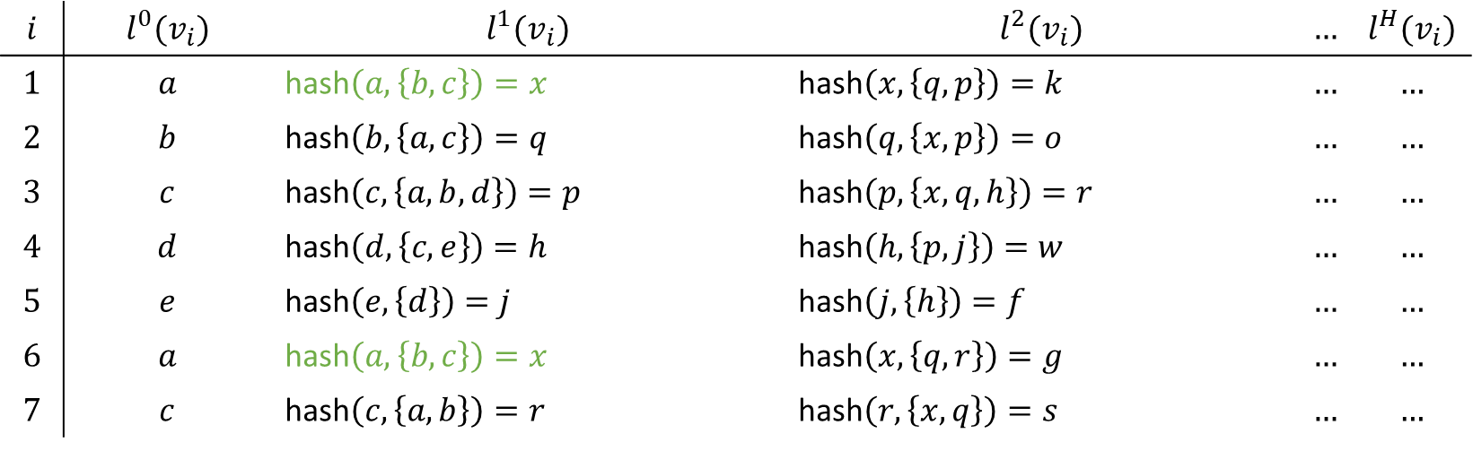
$$\left(v_{1} | x\right)$$
$$\left(v_{2} | q\right)$$
$$\left(v_{6} | x\right)$$
$$a$$
$$b$$
$$a$$
$$\left(v_{3} | p\right)$$
$$\left(v_{7} | r\right)$$
$$c$$
$$c$$
$$d$$
$$e$$
$$\left(v_{4} | h\right)$$
$$\left(v_{5} | j\right)$$
$$i$$ | $$l^{0}(v_{i})$$ | $$l^{1}(v_{i})$$ | $$l^{2}(v_{i})$$ | $$…$$ | $$l^{H}(v_{i})$$
$$1$$ | $$a$$ | hash$\left(a,\left\{b, c\right\}\right)=x$ | hash$\left(x,\left\{q, p\right\}\right)=k$ | $$…$$ | $$…$$
$$2$$ | $$b$$ | hash$\left(b,\left\{a, c\right\}\right)=q$ | hash$\left(q,\left\{x, p\right\}\right)=o$ | $$…$$ | $$…$$
$$3$$ | $$c$$ | hash$\left(c,\left\{a, b,d\right\}\right)=p$ | hash$\left(p,\left\{x,q,h\right\}\right)=r$ | $$…$$ | $$…$$
$$4$$ | $$d$$ | hash$\left(d,\left\{c, e\right\}\right)=h$ | hash$\left(h,\left\{p,j\right\}\right)=w$ | $$…$$ | $$…$$
$$5$$ | $$e$$ | hash$\left(e,\left\{d\right\}\right)=j$ | hash$\left(j,\left\{h\right\}\right)=f$ | $$…$$ | $$…$$
$$6$$ | $$a$$ | hash$\left(a,\left\{b, c\right\}\right)=x$ | hash$\left(x,\left\{q,r\right\}\right)=g$ | $$…$$ | $$…$$
$$7$$ | $$c$$ | hash$\left(c,\left\{a, b\right\}\right)=r$ | hash$\left(r,\left\{x,q\right\}\right)=s$ | $$…$$ | $$…$$
First-order neighbourhoods of $v_{1}$ and $v_{6}$ are the same

Slide 14
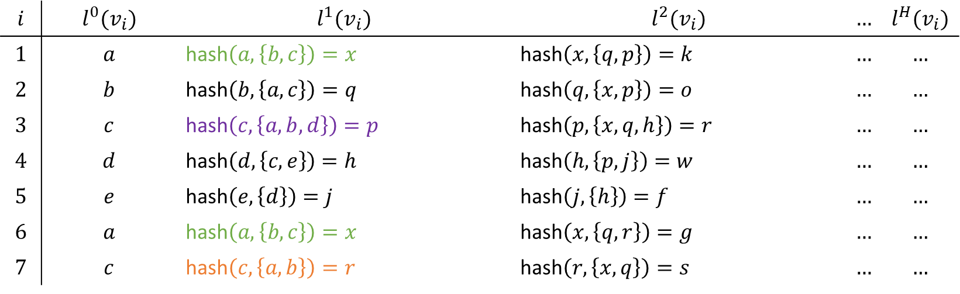
$$\left(v_{1} | x\right)$$
$$\left(v_{2} | q\right)$$
$$\left(v_{6} | x\right)$$
$$a$$
$$b$$
$$a$$
$$\left(v_{3} | p\right)$$
$$\left(v_{7} | r\right)$$
$$c$$
$$c$$
$$d$$
$$e$$
$$\left(v_{4} | h\right)$$
$$\left(v_{5} | j\right)$$
$$i$$ | $$l^{0}(v_{i})$$ | $$l^{1}(v_{i})$$ | $$l^{2}(v_{i})$$ | $$…$$ | $$l^{H}(v_{i})$$
$$1$$ | $$a$$ | hash$\left(a,\left\{b, c\right\}\right)=x$ | hash$\left(x,\left\{q, p\right\}\right)=k$ | $$…$$ | $$…$$
$$2$$ | $$b$$ | hash$\left(b,\left\{a, c\right\}\right)=q$ | hash$\left(q,\left\{x, p\right\}\right)=o$ | $$…$$ | $$…$$
$$3$$ | $$c$$ | hash$\left(c,\left\{a, b,d\right\}\right)=p$ | hash$\left(p,\left\{x,q,h\right\}\right)=r$ | $$…$$ | $$…$$
$$4$$ | $$d$$ | hash$\left(d,\left\{c, e\right\}\right)=h$ | hash$\left(h,\left\{p,j\right\}\right)=w$ | $$…$$ | $$…$$
$$5$$ | $$e$$ | hash$\left(e,\left\{d\right\}\right)=j$ | hash$\left(j,\left\{h\right\}\right)=f$ | $$…$$ | $$…$$
$$6$$ | $$a$$ | hash$\left(a,\left\{b, c\right\}\right)=x$ | hash$\left(x,\left\{q,r\right\}\right)=g$ | $$…$$ | $$…$$
$$7$$ | $$c$$ | hash$\left(c,\left\{a, b\right\}\right)=r$ | hash$\left(r,\left\{x,q\right\}\right)=s$ | $$…$$ | $$…$$

Slide 15
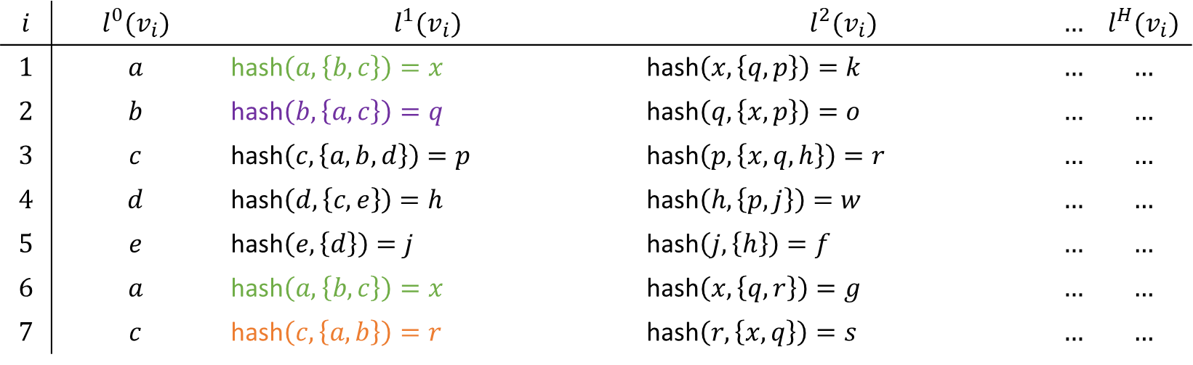
$$\left(v_{1} | x\right)$$
$$\left(v_{2} | q\right)$$
$$\left(v_{6} | x\right)$$
$$a$$
$$b$$
$$a$$
$$\left(v_{3} | p\right)$$
$$\left(v_{7} | r\right)$$
$$c$$
$$c$$
$$d$$
$$e$$
$$\left(v_{4} | h\right)$$
$$\left(v_{5} | j\right)$$
$$i$$ | $$l^{0}(v_{i})$$ | $$l^{1}(v_{i})$$ | $$l^{2}(v_{i})$$ | $$…$$ | $$l^{H}(v_{i})$$
$$1$$ | $$a$$ | hash$\left(a,\left\{b, c\right\}\right)=x$ | hash$\left(x,\left\{q, p\right\}\right)=k$ | $$…$$ | $$…$$
$$2$$ | $$b$$ | hash$\left(b,\left\{a, c\right\}\right)=q$ | hash$\left(q,\left\{x, p\right\}\right)=o$ | $$…$$ | $$…$$
$$3$$ | $$c$$ | hash$\left(c,\left\{a, b,d\right\}\right)=p$ | hash$\left(p,\left\{x,q,h\right\}\right)=r$ | $$…$$ | $$…$$
$$4$$ | $$d$$ | hash$\left(d,\left\{c, e\right\}\right)=h$ | hash$\left(h,\left\{p,j\right\}\right)=w$ | $$…$$ | $$…$$
$$5$$ | $$e$$ | hash$\left(e,\left\{d\right\}\right)=j$ | hash$\left(j,\left\{h\right\}\right)=f$ | $$…$$ | $$…$$
$$6$$ | $$a$$ | hash$\left(a,\left\{b, c\right\}\right)=x$ | hash$\left(x,\left\{q,r\right\}\right)=g$ | $$…$$ | $$…$$
$$7$$ | $$c$$ | hash$\left(c,\left\{a, b\right\}\right)=r$ | hash$\left(r,\left\{x,q\right\}\right)=s$ | $$…$$ | $$…$$

Slide 16
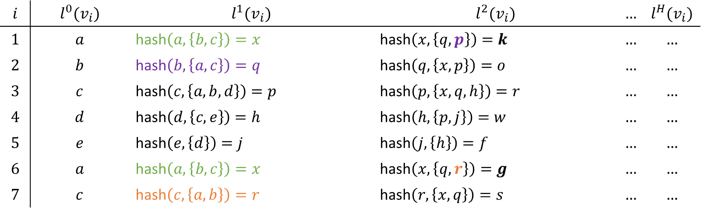
$$\left(v_{1} | x\right)$$
$$\left(v_{2} | q\right)$$
$$\left(v_{6} | x\right)$$
$$a$$
$$b$$
$$a$$
$$\left(v_{3} | p\right)$$
$$\left(v_{7} | r\right)$$
$$c$$
$$c$$
$$d$$
$$e$$
$$\left(v_{4} | h\right)$$
$$\left(v_{5} | j\right)$$
$$i$$ | $$l^{0}(v_{i})$$ | $$l^{1}(v_{i})$$ | $$l^{2}(v_{i})$$ | $$…$$ | $$l^{H}(v_{i})$$
$$1$$ | $$a$$ | hash$\left(a,\left\{b, c\right\}\right)=x$ | hash$\left(x,\left\{q, p\right\}\right)=k$ | $$…$$ | $$…$$
$$2$$ | $$b$$ | hash$\left(b,\left\{a, c\right\}\right)=q$ | hash$\left(q,\left\{x, p\right\}\right)=o$ | $$…$$ | $$…$$
$$3$$ | $$c$$ | hash$\left(c,\left\{a, b,d\right\}\right)=p$ | hash$\left(p,\left\{x,q,h\right\}\right)=r$ | $$…$$ | $$…$$
$$4$$ | $$d$$ | hash$\left(d,\left\{c, e\right\}\right)=h$ | hash$\left(h,\left\{p,j\right\}\right)=w$ | $$…$$ | $$…$$
$$5$$ | $$e$$ | hash$\left(e,\left\{d\right\}\right)=j$ | hash$\left(j,\left\{h\right\}\right)=f$ | $$…$$ | $$…$$
$$6$$ | $$a$$ | hash$\left(a,\left\{b, c\right\}\right)=x$ | hash$\left(x,\left\{q,r\right\}\right)=g$ | $$…$$ | $$…$$
$$7$$ | $$c$$ | hash$\left(c,\left\{a, b\right\}\right)=r$ | hash$\left(r,\left\{x,q\right\}\right)=s$ | $$…$$ | $$…$$
Second-order neighbourhoods of $v_{1}$ and $v_{6}$ are NOT the same

Slide 17
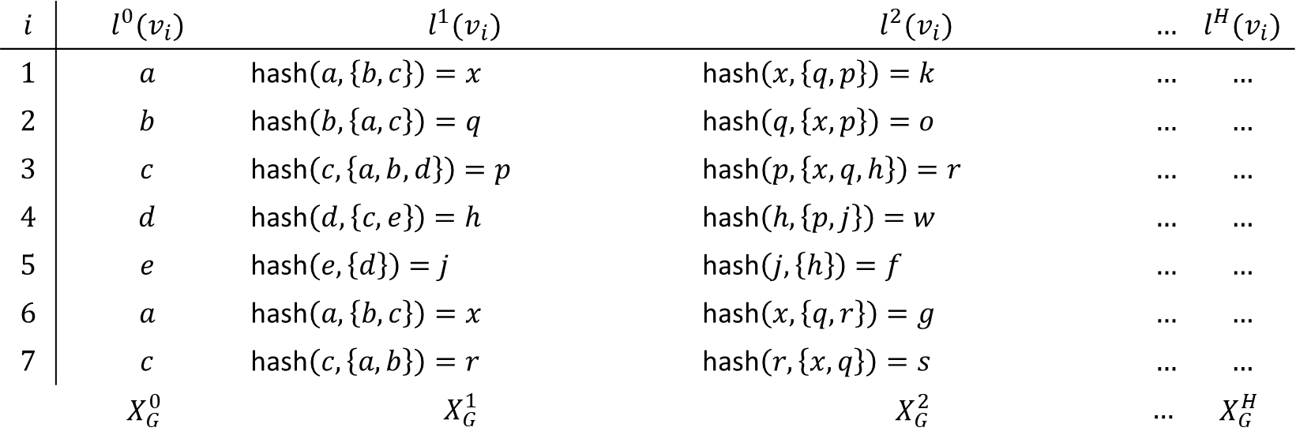
$$\left(v_{1} | x\right)$$
$$\left(v_{2} | q\right)$$
$$\left(v_{6} | x\right)$$
$$a$$
$$b$$
$$a$$
$$\left(v_{3} | p\right)$$
$$\left(v_{7} | r\right)$$
$$c$$
$$c$$
$$d$$
$$e$$
$$\left(v_{4} | h\right)$$
$$\left(v_{5} | j\right)$$
$$i$$ | $$l^{0}(v_{i})$$ | $$l^{1}(v_{i})$$ | $$l^{2}(v_{i})$$ | $$…$$ | $$l^{H}(v_{i})$$
$$1$$ | $$a$$ | hash$\left(a,\left\{b, c\right\}\right)=x$ | hash$\left(x,\left\{q, p\right\}\right)=k$ | $$…$$ | $$…$$
$$2$$ | $$b$$ | hash$\left(b,\left\{a, c\right\}\right)=q$ | hash$\left(q,\left\{x, p\right\}\right)=o$ | $$…$$ | $$…$$
$$3$$ | $$c$$ | hash$\left(c,\left\{a, b,d\right\}\right)=p$ | hash$\left(p,\left\{x,q,h\right\}\right)=r$ | $$…$$ | $$…$$
$$4$$ | $$d$$ | hash$\left(d,\left\{c, e\right\}\right)=h$ | hash$\left(h,\left\{p,j\right\}\right)=w$ | $$…$$ | $$…$$
$$5$$ | $$e$$ | hash$\left(e,\left\{d\right\}\right)=j$ | hash$\left(j,\left\{h\right\}\right)=f$ | $$…$$ | $$…$$
$$6$$ | $$a$$ | hash$\left(a,\left\{b, c\right\}\right)=x$ | hash$\left(x,\left\{q,r\right\}\right)=g$ | $$…$$ | $$…$$
$$7$$ | $$c$$ | hash$\left(c,\left\{a, b\right\}\right)=r$ | hash$\left(r,\left\{x,q\right\}\right)=s$ | $$…$$ | $$…$$
 | $$X_{G}^{0}$$ | $$X_{G}^{1}$$ | $$X_{G}^{2}$$ | $$…$$ | $$X_{G}^{H}$$
Feature node vector of graph G at iteration h (contains labels with information about the h-th-order neighbourhoods)
$l^{0}(v_{i})∈ℝ^{m}$ - with $m$ being the dimensionality of the node labels (there $m=1$)
$f^{H}:G⟶\left[X_{G}^{0}X_{G}^{1}…X_{G}^{H}\right]∈ℝ^{n_{G}×m(H+1)}$ - with $n_{G}$ being the cardinality of the vertex set (there $n_{G}=7$)

Slide 18
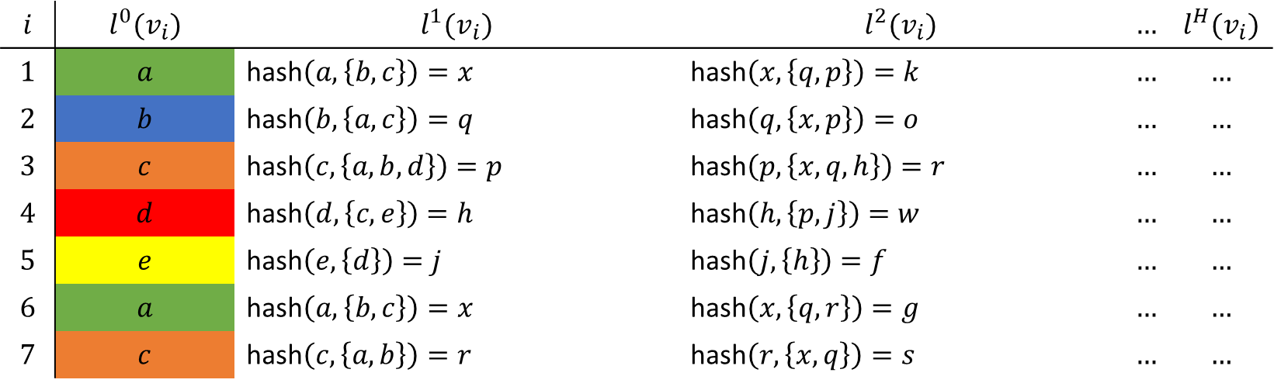
$$\left(v_{1} | a\right)$$
$$\left(v_{2} | b\right)$$
$$\left(v_{6} | a\right)$$
$$\left(v_{3} | c\right)$$
$$\left(v_{7} | c\right)$$
$$\left(v_{4} | d\right)$$
$$\left(v_{5} | e\right)$$
$$i$$ | $$l^{0}(v_{i})$$ | $$l^{1}(v_{i})$$ | $$l^{2}(v_{i})$$ | $$…$$ | $$l^{H}(v_{i})$$
$$1$$ | $$a$$ | hash$\left(a,\left\{b, c\right\}\right)=x$ | hash$\left(x,\left\{q, p\right\}\right)=k$ | $$…$$ | $$…$$
$$2$$ | $$b$$ | hash$\left(b,\left\{a, c\right\}\right)=q$ | hash$\left(q,\left\{x, p\right\}\right)=o$ | $$…$$ | $$…$$
$$3$$ | $$c$$ | hash$\left(c,\left\{a, b,d\right\}\right)=p$ | hash$\left(p,\left\{x,q,h\right\}\right)=r$ | $$…$$ | $$…$$
$$4$$ | $$d$$ | hash$\left(d,\left\{c, e\right\}\right)=h$ | hash$\left(h,\left\{p,j\right\}\right)=w$ | $$…$$ | $$…$$
$$5$$ | $$e$$ | hash$\left(e,\left\{d\right\}\right)=j$ | hash$\left(j,\left\{h\right\}\right)=f$ | $$…$$ | $$…$$
$$6$$ | $$a$$ | hash$\left(a,\left\{b, c\right\}\right)=x$ | hash$\left(x,\left\{q,r\right\}\right)=g$ | $$…$$ | $$…$$
$$7$$ | $$c$$ | hash$\left(c,\left\{a, b\right\}\right)=r$ | hash$\left(r,\left\{x,q\right\}\right)=s$ | $$…$$ | $$…$$

Slide 19
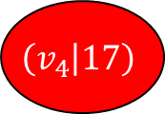

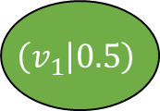
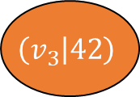


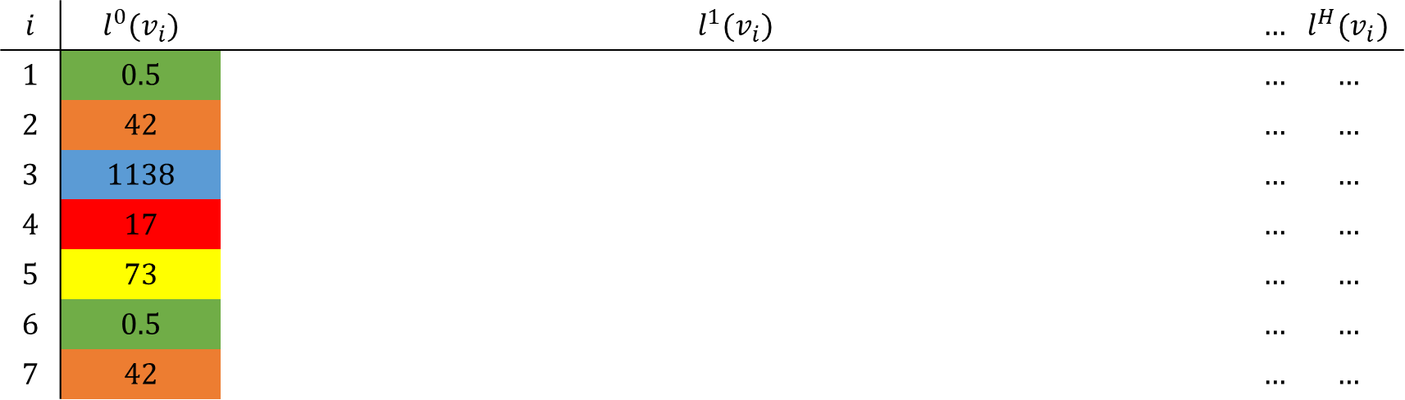

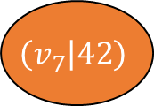

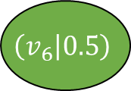


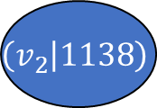
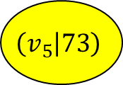

$$\left(v_{1} | 0.5\right)$$
$$0.9$$
$$\left(v_{2} | 1138\right)$$
$$0.9$$
$$\left(v_{6} | 0.5\right)$$
$$13$$
$$13$$
$$110$$
$$110$$
$$\left(v_{3} | 42\right)$$
$$\left(v_{7} | 42\right)$$
$$0.25$$
$$\left(v_{4} | 17\right)$$
$$7$$
$$\left(v_{5} | 73\right)$$
$$i$$ | $$l^{0}(v_{i})$$ | $$l^{1}(v_{i})$$ | $$…$$ | $$l^{H}(v_{i})$$
$$1$$ | $$0.5$$ |  | $$…$$ | $$…$$
$$2$$ | $$42$$ |  | $$…$$ | $$…$$
$$3$$ | $$1138$$ |  | $$…$$ | $$…$$
$$4$$ | $$17$$ |  | $$…$$ | $$…$$
$$5$$ | $$73$$ |  | $$…$$ | $$…$$
$$6$$ | $$0.5$$ |  | $$…$$ | $$…$$
$$7$$ | $$42$$ |  | $$…$$ | $$…$$

Slide 20
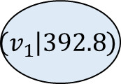
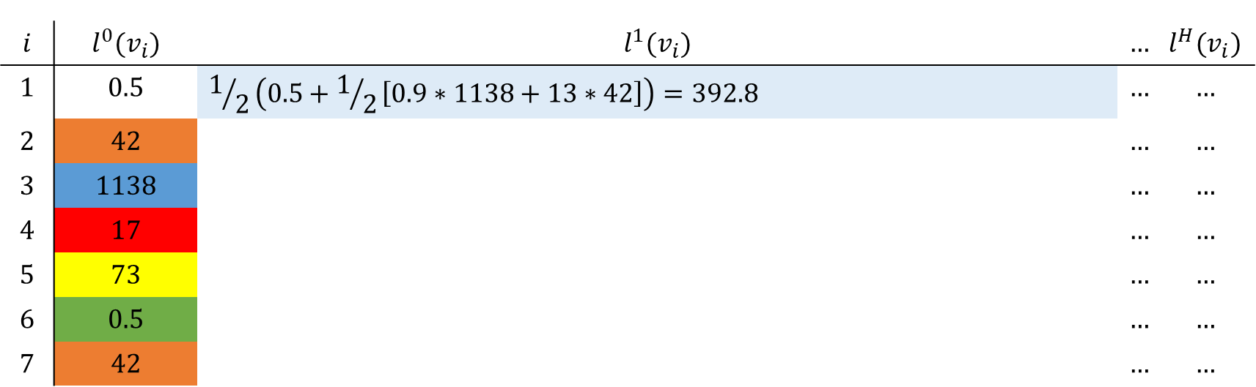
$$\left(v_{1} | 392.8\right)$$
$$0.9$$
$$\left(v_{2} | 1138\right)$$
$$0.9$$
$$\left(v_{6} | 0.5\right)$$
$$13$$
$$13$$
$$110$$
$$110$$
$$\left(v_{3} | 42\right)$$
$$\left(v_{7} | 42\right)$$
$$0.25$$
$$\left(v_{4} | 17\right)$$
$$7$$
$$\left(v_{5} | 73\right)$$
$$i$$ | $$l^{0}(v_{i})$$ | $$l^{1}(v_{i})$$ | $$…$$ | $$l^{H}(v_{i})$$
$$1$$ | $$0.5$$ | $$1/2\left(0.5+1/2\left[0.9∗1138+13∗42\right]\right)=392.8$$ | $$…$$ | $$…$$
$$2$$ | $$42$$ |  | $$…$$ | $$…$$
$$3$$ | $$1138$$ |  | $$…$$ | $$…$$
$$4$$ | $$17$$ |  | $$…$$ | $$…$$
$$5$$ | $$73$$ |  | $$…$$ | $$…$$
$$6$$ | $$0.5$$ |  | $$…$$ | $$…$$
$$7$$ | $$42$$ |  | $$…$$ | $$…$$

Slide 21
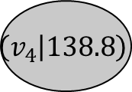
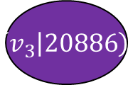
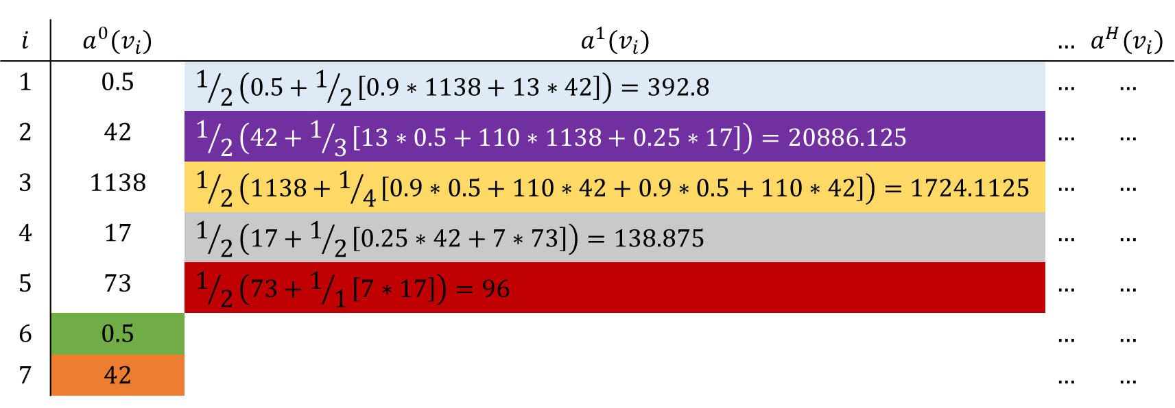
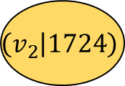
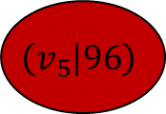
$$\left(v_{1} | 392.8\right)$$
$$0.9$$
$$\left(v_{2} | 1724\right)$$
$$0.9$$
$$\left(v_{6} | 0.5\right)$$
$$13$$
$$13$$
$$110$$
$$110$$
$$\left(v_{3} | 20886\right)$$
$$\left(v_{7} | 42\right)$$
$$0.25$$
$$\left(v_{4} | 138.8\right)$$
$$7$$
$$\left(v_{5} | 96\right)$$
$$i$$ | $$a^{0}(v_{i})$$ | $$a^{1}(v_{i})$$ | $$…$$ | $$a^{H}(v_{i})$$
$$1$$ | $$0.5$$ | $$1/2\left(0.5+1/2\left[0.9∗1138+13∗42\right]\right)=392.8$$ | $$…$$ | $$…$$
$$2$$ | $$42$$ | $$1/2\left(42+1/3\left[13∗0.5+110∗1138+0.25∗17\right]\right)=20886.125$$ | $$…$$ | $$…$$
$$3$$ | $$1138$$ | $$1/2\left(1138+1/4\left[0.9∗0.5+110∗42+0.9∗0.5+110∗42\right]\right)=1724.1125$$ | $$…$$ | $$…$$
$$4$$ | $$17$$ | $$1/2\left(17+1/2\left[0.25∗42+7∗73\right]\right)=138.875$$ | $$…$$ | $$…$$
$$5$$ | $$73$$ | $$1/2\left(73+1/1\left[7∗17\right]\right)=96$$ | $$…$$ | $$…$$
$$6$$ | $$0.5$$ |  | $$…$$ | $$…$$
$$7$$ | $$42$$ |  | $$…$$ | $$…$$

Slide 22
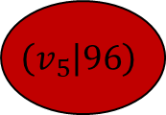

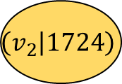
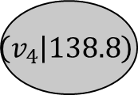

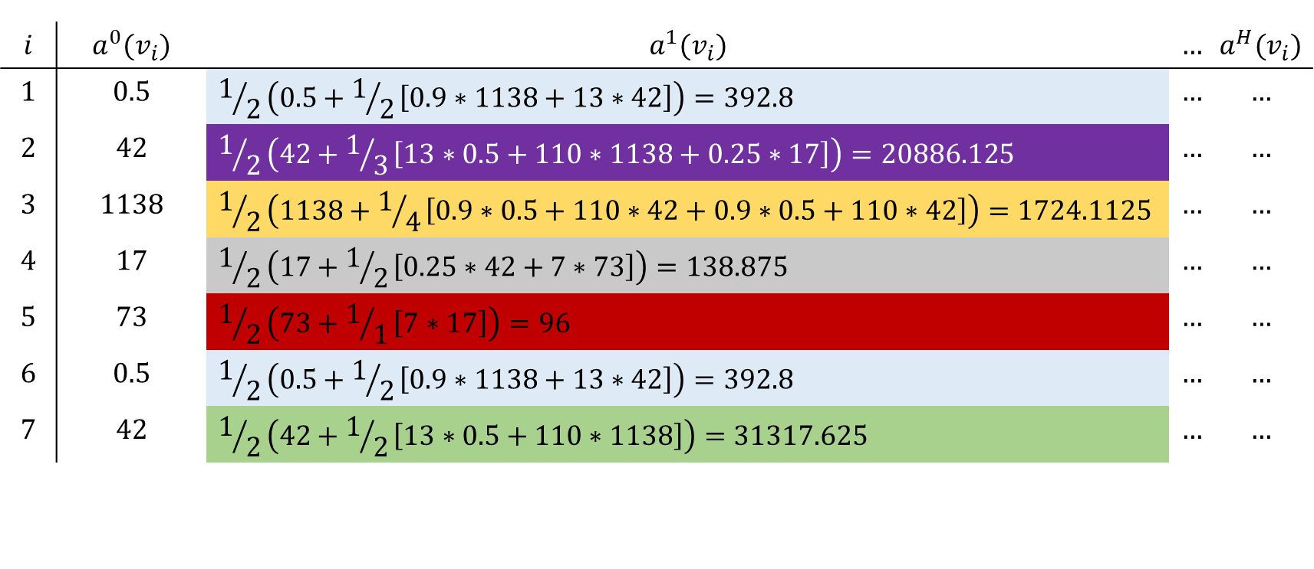
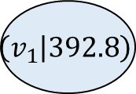









$$\left(v_{1} | 392.8\right)$$
$$0.9$$
$$\left(v_{2} | 1724\right)$$
$$0.9$$
$$\left(v_{6} | 392.8\right)$$
$$13$$
$$13$$
$$110$$
$$110$$
$$\left(v_{3} | 20886\right)$$
$$\left(v_{7} | 31317\right)$$
$$0.25$$
$$\left(v_{4} | 138.8\right)$$
$$7$$
$$\left(v_{5} | 96\right)$$
$$i$$ | $$a^{0}(v_{i})$$ | $$a^{1}(v_{i})$$ | $$…$$ | $$a^{H}(v_{i})$$
$$1$$ | $$0.5$$ | $$1/2\left(0.5+1/2\left[0.9∗1138+13∗42\right]\right)=392.8$$ | $$…$$ | $$…$$
$$2$$ | $$42$$ | $$1/2\left(42+1/3\left[13∗0.5+110∗1138+0.25∗17\right]\right)=20886.125$$ | $$…$$ | $$…$$
$$3$$ | $$1138$$ | $$1/2\left(1138+1/4\left[0.9∗0.5+110∗42+0.9∗0.5+110∗42\right]\right)=1724.1125$$ | $$…$$ | $$…$$
$$4$$ | $$17$$ | $$1/2\left(17+1/2\left[0.25∗42+7∗73\right]\right)=138.875$$ | $$…$$ | $$…$$
$$5$$ | $$73$$ | $$1/2\left(73+1/1\left[7∗17\right]\right)=96$$ | $$…$$ | $$…$$
$$6$$ | $$0.5$$ | $$1/2\left(0.5+1/2\left[0.9∗1138+13∗42\right]\right)=392.8$$ | $$…$$ | $$…$$
$$7$$ | $$42$$ | $$1/2\left(42+1/2\left[13∗0.5+110∗1138\right]\right)=31317.625$$ | $$…$$ | $$…$$

Slide 23
$$\left(v_{1} | 392.8\right)$$
$$0.9$$
$$\left(v_{2} | 1724\right)$$
$$0.9$$
$$\left(v_{6} | 392.8\right)$$
$$13$$
$$13$$
$$110$$
$$110$$
$$\left(v_{3} | 20886\right)$$
$$\left(v_{7} | 31317\right)$$
$$0.25$$
$$\left(v_{4} | 138.8\right)$$
$$7$$
$$\left(v_{5} | 96\right)$$
$$i$$ | $$a^{0}(v_{i})$$ | $$a^{1}(v_{i})$$ | $$…$$ | $$a^{H}(v_{i})$$
$$1$$ | $$0.5$$ | $$1/2\left(0.5+1/2\left[0.9∗1138+13∗42\right]\right)=392.8$$ | $$…$$ | $$…$$
$$2$$ | $$42$$ | $$1/2\left(42+1/3\left[13∗0.5+110∗1138+0.25∗17\right]\right)=20886.125$$ | $$…$$ | $$…$$
$$3$$ | $$1138$$ | $$1/2\left(1138+1/4\left[0.9∗0.5+110∗42+0.9∗0.5+110∗42\right]\right)=1724.1125$$ | $$…$$ | $$…$$
$$4$$ | $$17$$ | $$1/2\left(17+1/2\left[0.25∗42+7∗73\right]\right)=138.875$$ | $$…$$ | $$…$$
$$5$$ | $$73$$ | $$1/2\left(73+1/1\left[7∗17\right]\right)=96$$ | $$…$$ | $$…$$
$$6$$ | $$0.5$$ | $$1/2\left(0.5+1/2\left[0.9∗1138+13∗42\right]\right)=392.8$$ | $$…$$ | $$…$$
$$7$$ | $$42$$ | $$1/2\left(42+1/2\left[13∗0.5+110∗1138\right]\right)=31317.625$$ | $$…$$ | $$…$$

Slide 24




Slide 25



$$D\left(p,q\right)≤\left(1+ε\right)r$$
Contained by a blue ball?
no
yes
$$D\left(p,q\right)≤r$$
„NO“
Contained by a red ball?
no
yes – with probability dffsdfsdfat least $1−δ$
„NO“
„YES“ + center of one blue ball
„YES“ + center of one blue ball

